Slide 1
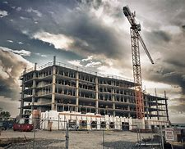
BUILDING A PREDICTION MODEL TO TO PREDICT CONSTRUCTION DELAY

Slide 2
SCOPE OF THE PROJECT
The Objectives of this project attempts to generalize:
To identify various factors that cause the delays. How unpredicted delays can cause delays resulting in delays of the total project. The effects of the delays on the project.
Study the causes and effects of the delays at various projects and to find out the most important causes . To identify the relevant ways of eliminating or mitigating the delays of construction

Slide 3

Hello world!
WE ARE HERE TO PRESENT OUR MINI PROJECT
PRESENTATION

Slide 4
1. INTRODUCTION
Let’s start with the first intro of project

Slide 5
“Some people worry that artificial intelligence will make us feel inferior, but then, anybody in his right mind should have an inferiority complex every time he looks at a flower.”
—Alan Kay

Slide 6
INTRODUCTION
Productivity is a very important element in the process of construction project management especially with regard to the estimation of the duration of the construction activities, this study aims at developing construction productivity estimating model for marble finishing works of floors using Multivariable Linear Regression technique (MLR).

Slide 7
INTRODUCTION
Ten influencing factors are utilized for productivity forecasting by MLR model, and they include age, experience, number of the assist labor, height of the floor, size of the marbles tiles, security conditions, health status for the work team, weather conditions, site condition, and availability of construction materials.

Slide 8
INTRODUCTION
It was found that MLR have the ability to predict the productivity for finishing works with excellent degree of accuracy of the coefficient of correlation (R) 90.6%, and average accuracy percentage of 96.3%.

Slide 9
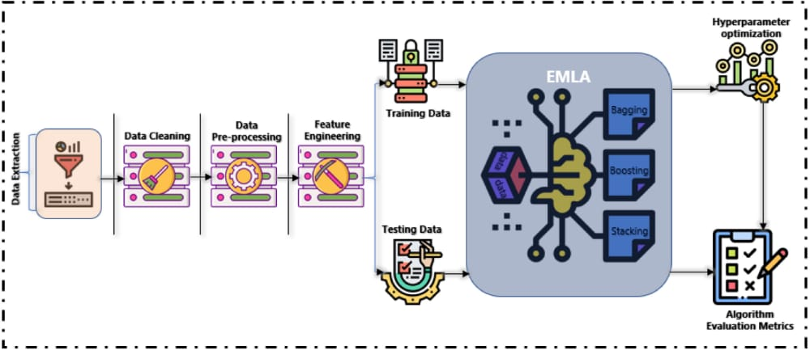
THE CONCEPT
CUTTING TO THE CHASE,WHAT’S THE STIR ABOUT

Slide 10
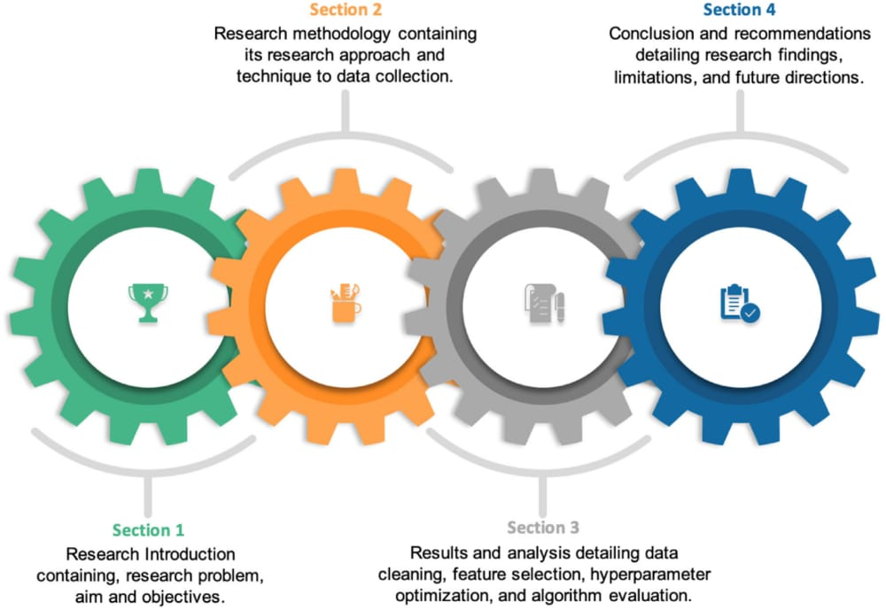
THE PROCESS

Slide 11
Multivariable Linear Regression
Productivity rates of construction trades are the basis for accurately estimating time and costs required to complete a project. Productivity could be defined as “the ratio of output of required quality to the inputs” for a specific production situation; in the construction industry, it is generally accepted as “work.
Productivity measurement provides the necessary data to analyze factors for project owners, constructors, and management professionals to control construction progress, estimate the cost of future construction projects, and determine its competitiveness in the global market. output per man-hours worked”.

Slide 12
Literature Survey
1) This study aimed at activity estimating model for marble finishing works of floors using multiple regression techniques. The model was developed based on 100 set of data collected in Iraq. Such types of models are very useful, especially in its simplicity and ability to be handled by calculator or a simple computer program

Slide 13
Literature Survey
2) Multivariable Linear Regression is used to examine several variables at once and the interrelationships between them. And MLR has the ability to predict the productivity of marble finishing works for floors with high degree of accuracy with 96.3% and the coefficients of determination R2 for the developed models equal to 0.8213. This indicates that the relationship between the independent variables of the developed models is good and the predicted values from a forecast model fit with the real-life data.

Slide 14
Literature Survey
3) In this research, ten influential variables developing construction productivity estimating model. Size marbles have most significant effect on the productivity of marble finishing works for floors equal to 46.901 as an unstandardized coefficients. While the other input variables have moderate impact on the productivity such as health status of work team.

Slide 15
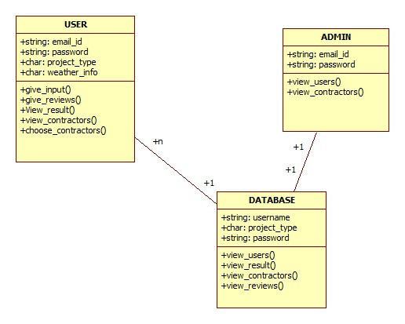
Methodology
In the proposed system ,we are building a prediction model generated using Naive Bayes algorithm. This model takes some of the most important delay cauing factors such as weather condition, no. of labours, financial delay ,etc as input to the system.
Using this, the output is predicted whether it is delayed or not. After that delay causing factors are identified and trying to rectify it to deliver the project asp. And finally ,it Provide the best result for the construction industry.

Slide 16
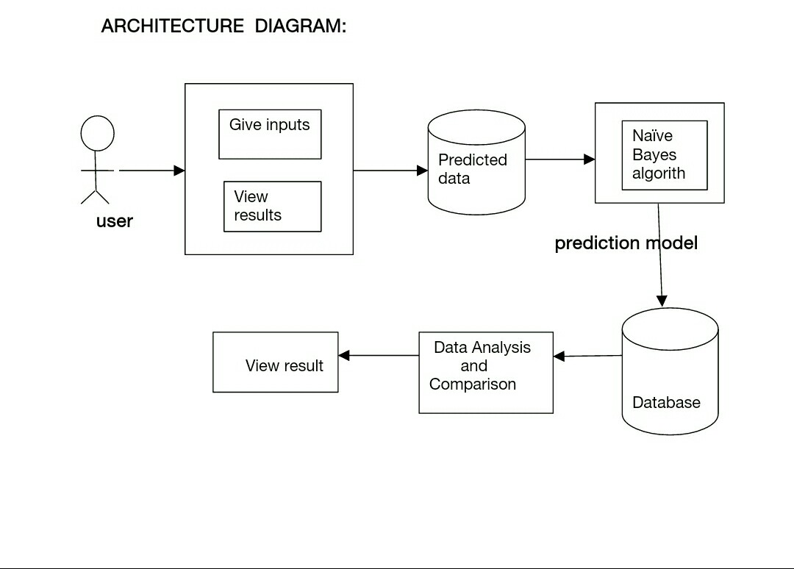
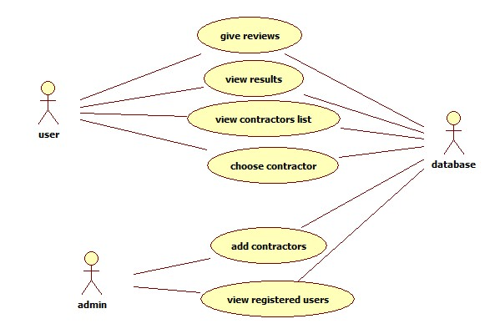
Architecture Diagram
In this model, User can give the reviews about the contractors. Based on the reviews, some users can choosen the contractors. User can choose the contractors based on the probability values of the contractors generated by the system using the algorithm. The results of the previous project are stored in the database

Slide 17
4.MODULES AND METHODS
1)Literature Review:
The review synthesized the findings from previous literature in textbooks, journal papers, research reports, conference proceedings, theses, dissertations, and Internet publications, and methods of productivity data analyses.
2) Data collection:
The researcher conducted on-site construction productivity measurements in the Iraq. The data were collected from observation and recompiled to a spreadsheet format that is suitable for statistical data analysis by using computer software, such as Statistical Package for the Social Sciences (SPSS)

Slide 18
4.MODULES AND METHODS
.3) Data analysis and comparison:
The data analysis were conducted by using the statistical software package, SPSS 19.0, for determining the productivity rate
4) Developed model:
Based on the data analyses results, it will provide Multiple Linear Regression model to predicting productivity of marble finishing works for floors and discuses the results from training and testing this model;
5) Validation model: This stage, which presents the validation of the MLR modelcharacteristics, and labor productivity .

Slide 19
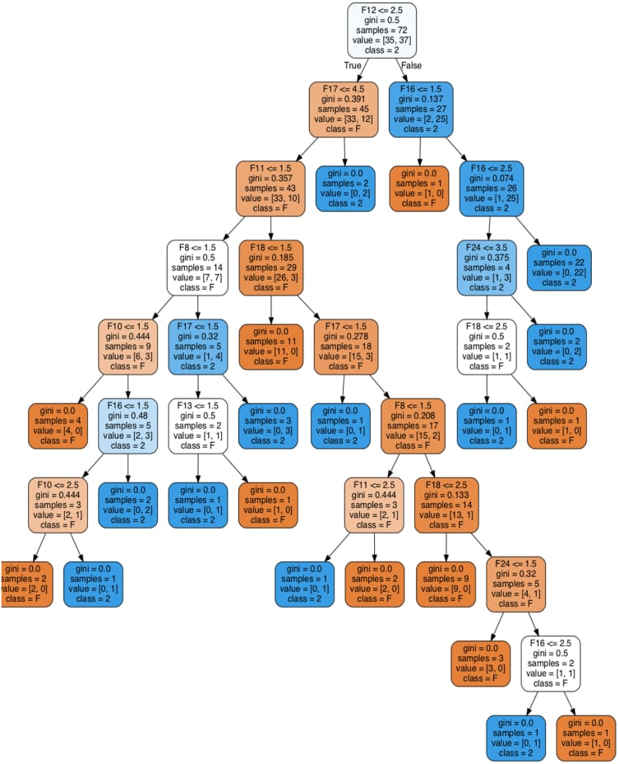
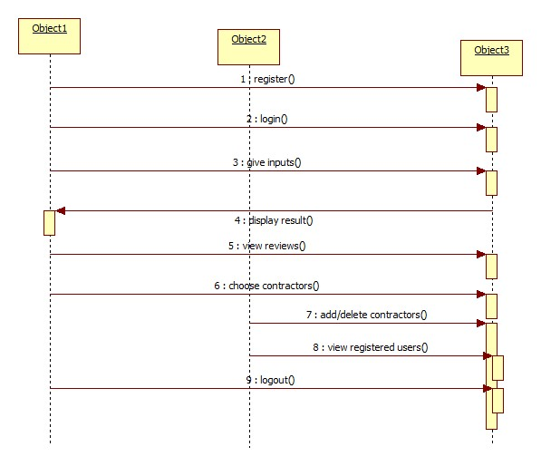
SOURCE CODE

Slide 20
RESULTS
The output of the project is driven from given input. When the input is given based on that output is revealed in the screen i.e, whether the project got delayed or not.
If the result , we get as delayed then the user need to identify the delay cauing factors and identifies the methods to resolve.

Slide 21
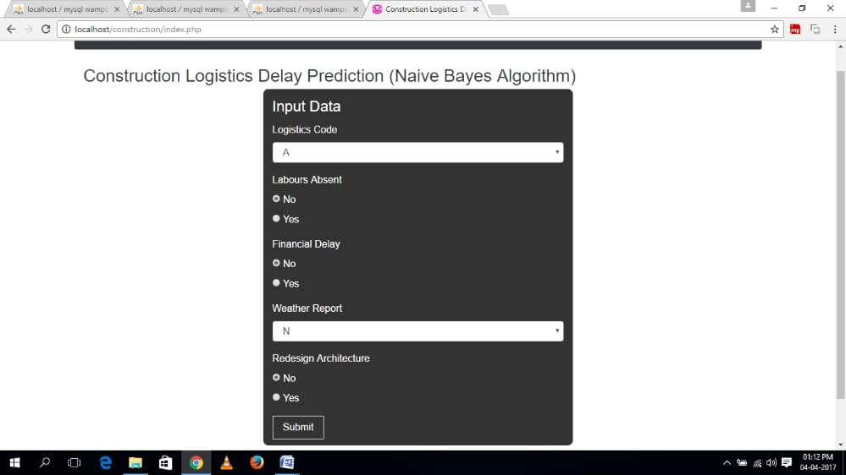
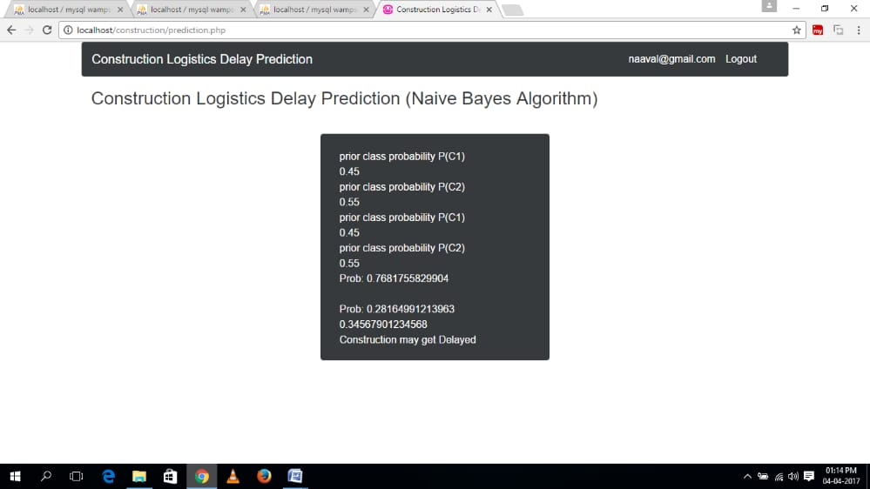
RESULTS

Slide 22
SUMMARY
We have discussed number of techniques for identification of delay causing factors. In this proposed work, algorithm used to retrieve relevant information about the construction industry and also consider the previous data as reference. Data mining concept can be applied to find the best contractors for a construction project, as till now available system found multiple contractors for a single construction project and the users have to choose the best among them so to overcome this limitation out proposed Identifying Best contractors For a construction industry Using the algorithm implemented in the model.

Slide 23
Machine intelligence is the last invention that humanity will ever need to make.”— Nick Bostrom
THANK YOU

